Slide 1
PERCEIVED RISKS & RISKS MITIGATION PRACTICES: A Qualitative Study with the Informal Waste Workers in Kathmandu Valley
Sujata Sapkota
Research Lead, PHASE Nepal
Suryabinayak, Bhaktapur, Nepal

Slide 2
Perceived risks and risks mitigation practices: qualitative study in informal waste workers- Sujata Sapkota

Slide 3
Team
PHASE Nepal:
Jiban Karki, Sujata Sapkota, Gerda Pohl, Yuba Raj Baral, Prabina Makai, Saraswati Adhikari
School of Health and Related Research, The University of Sheffield:
Andrew CK Lee, Michelle Black
Médecins du Monde:
Nita Chaudhari, Guillame Fauvel, Astrid Fossier-Heckmen

Slide 4
Presentation Outline
Project Background
Quantitative study
Qualitative Study- background and aims
Findings
Recommendations

Slide 5
Background
Project : Healthy Waste Workers in Kathmandu Valley
Médecins du monde/ PHASE Nepal
Need for research:
Lack of epidemiological data on IWWs
Facing significant occupational & health risks
Dependent on insufficient earnings & low socio-economic status
Involved in risky behaviors/exposure
PHASE Nepal/ The University of Sheffield/ Medicines du Monde
Mixed-Method: Quantitative, followed by, Qualitative research
Ethical Approval: Nepal Health Research Council (Reg. No. 388/217)
Perceived risks and risks mitigation practices: qualitative study in informal waste workers- Sujata Sapkota

Slide 6
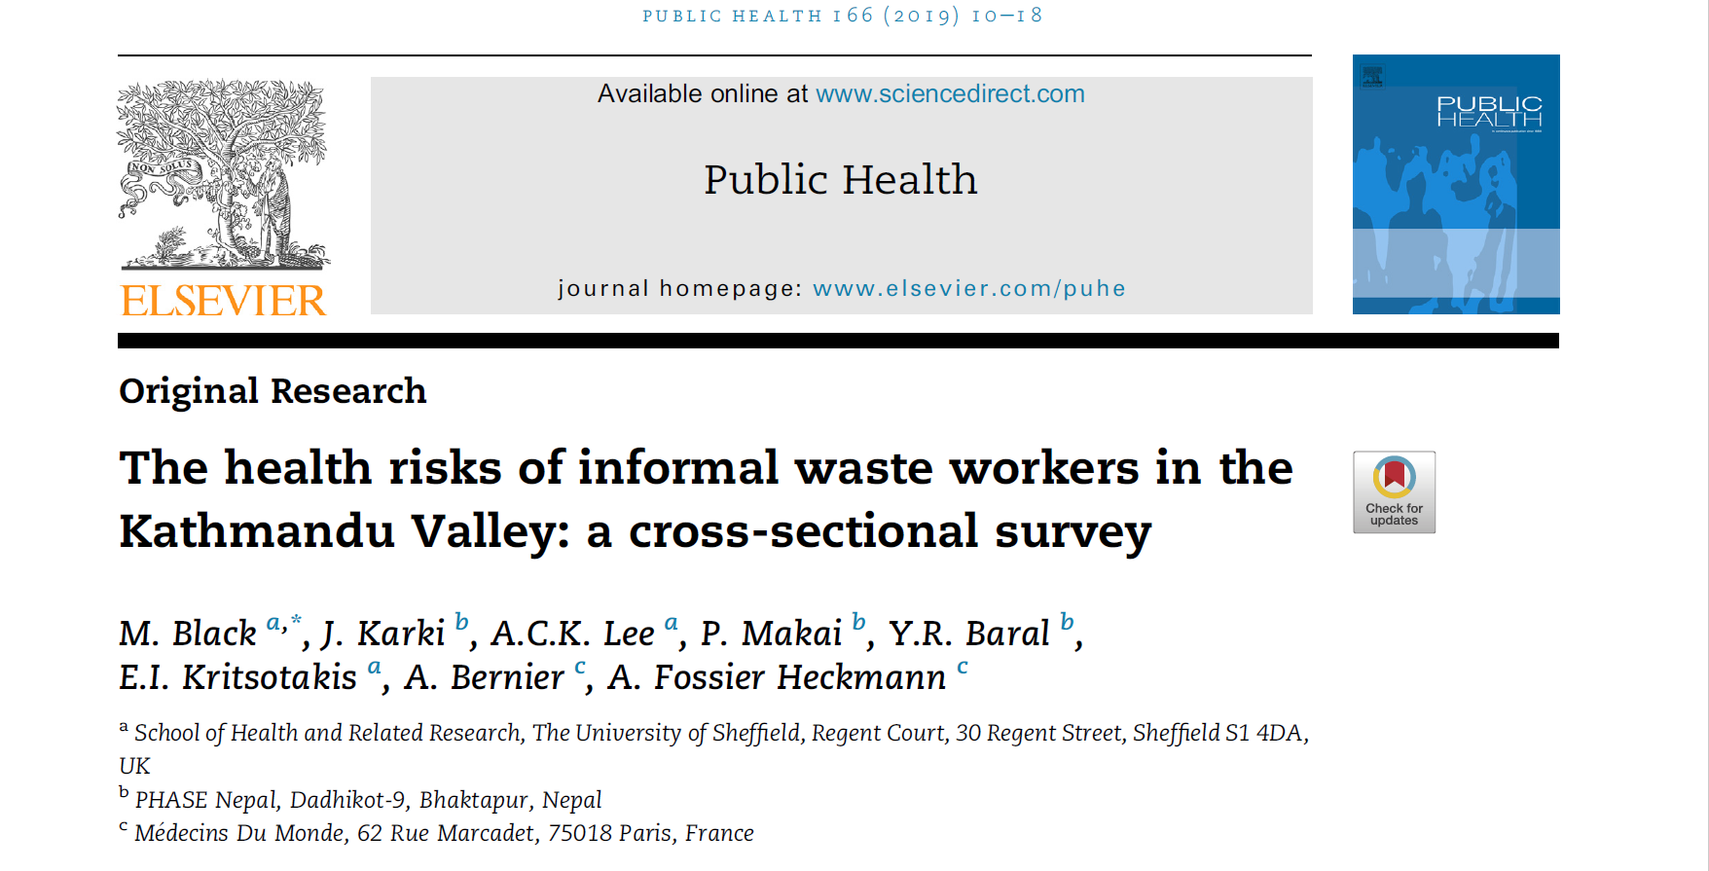
Quantitative Research
Cross-sectional survey
1278 Informal Waste Workers (IWWs) were interviewed [mid-November 2017 to mid-December 2017]
Site:
Shantinagar and Teku in Kathmandu Valley & Sisdole in Nuwakot
A range of issue were studied:
General Health
Tobacco, drugs and alcohol
Healthcare access and utilization
Heart-mind problems/ depressive level
Sexual & Reproductive Health
Disability
Social Security
Employment and Financial Situation
Knowledge of health risks related to waste-work
Personal protection
Analysis of PPE Use
Analysis of Risk perceptions

Slide 7
Qualitative Research
AIM:
To explore the perceptions of risks and risks mitigation strategies in waste workers in Nepal
OBJECTIVES:
To explore
waste-workers’ understandings and attitudes of their occupational health risks
what factors influence waste workers’ behaviors towards using personal protective equipment in their work
what factors would lead to change in in behavior in relation to protecting themselves from health risks in their work
IWWs’ alcohol and tobacco consumption practices
waste workers’ health seeking behavior and their perceptions of attitudes of healthcare providers towards IWWs
Perceived risks and risks mitigation practices: qualitative study in informal waste workers- Sujata/PHASE Nepal

Slide 8
Methods
Sites// Participant Selection
Shantinagar, Teku and Sisdole// Convenience/ Snow-ball
Data collection
Face to face In-depth Interviews:
18 IWWs interviewed (13 Male/ 5 Female)
Focused Group Discussions:
4 FGDs (1 Nepali group: 11; 1 female-only group: 9; 2 mixed-sex groups: 15 & 14)
Data and Analysis
Audio-recorded, Transcribed Verbatim, Translated and Thematically analyzed
Perceived risks and risks mitigation practices: qualitative study in informal waste workers- Sujata Sapkota

Slide 9
Findings:
Themes |  | Sub-themes
1 | IWWs’ involvement in waste-work | Reasons for involvement in waste-work Nature of work performed
2 | Risks associated with waste-work: perceptions & experiences | 1. Discrimination 2. Health Risks
3 | Risk mitigation strategies: perceptions and practices | 1. Stay away/ Be careful 2. Use of protection/ PPE 3. Self-care/ health-care
4 | Barriers to PPE use | 1. Inconvenience 2. Unaffordable 3. Not a norm/ Habit 4. Perceptions that PPE is not necessary
5 | Strategies to promote safety and reduce risks | Strategies to promote the use of PPE Other strategies/ mechanisms to promote safety
6 7 8 9 | Hygiene and sanitation practice Tobacco use & alcohol consumption Mental Health Support System

Slide 10
IWWs’ involvement in waste-work
Reasons for involvement in waste-work
Negative Drivers
Illiteracy
Positive Drivers
Money earned
Perceived lack of skills
Lack of qualifications to perform other jobs
Unemployment
Poverty
Low-barriers to entry
Better climatic and work conditions (compared to India)
Having a family member or friend engaged in waste work
Flexible nature
Freedom
Nature of work performed:
Collecting wastes
Sorting wastes
“whatever was asked of them”
Perceived risks and risks mitigation practices: qualitative study in informal waste workers- Sujata/PHASE Nepal

Slide 11
Risks associated with waste-work
“Some people scold [us] and behave badly. … some people use offensive language; some people cheat; some people scold, scrap dealers also shout at me. I feel bad when people behave in that way, that really hurts. It is the saddest part. This is not a trivial work. …. Everyone dominate us saying we work with waste. Old people who do not understand are disrespectful. They think that I cheat them. …. What to say…relatives also look down on me. They drink and scold me saying that I am doing an awful job. While walking people use vulgar words to scold me and say that I should be cheated and beaten.” (I3, M)
DISCRIMINATION
“This is a very risky job…if someone steals something and I am on the way, people catch me and blame me. They slap me as well. They take me into police custody. They ask for money. “ (I5, M)

Slide 12
“If I share this with my relative or villagers they will hate us saying you are working in waste. They said you did not get any other job in the Kathmandu…how you can do work in that waste… there is bad smell… even we don’t say that we work in the waste in our children’s school. If we share this in the school, teachers, parents and our children’s friends will look at our children in a different way. We never talk openly about our job due to discrimination in the society. In the early days of my work in the field if people knew that you are working in waste it is very difficult to get a room in Kathmandu. My children go to private boarding school but I never tell my children’s teacher that I am working in waste due to shame and discrimination in the society. If other people hear what I am saying they will treat my children in a different way.”
(FGD4, P8, F)
Perceived risks and risks mitigation practices: qualitative study in informal waste workers- Sujata/PHASE Nepal

Slide 13
HEALTH RISKS
Injuries – cuts/ pricks/ needle-stick injury/ metals
Road Traffic Accidents
Physical Injuries –resulting from vehicles and machines
Injuries from machines, dozers and vehicles: Sisdole
Dog-bites
Ergonomic hazards: back-ache
Health issues commonly experienced: cough, headache, body-ache, fever and chest issues; dog bites
Perceived risks and risks mitigation practices: qualitative study in informal waste workers- Sujata/PHASE Nepal

Slide 14
Risk mitigation strategies
Stay Away / Being Careful
“I have to accept such kind of behaviours since I come to a different place. I don’t do anything, I just work. I am here not for a fight. There is no place to complain about it. I keep myself silent and walk like nothing has happened, to continue my work, collect the waste and come to the scrap dealer. That’s it.” (I3, M)
“If there are dogs, I have to keep a distance. If there is glass, I have to be careful. Then, I should not go near drunkards…I have to pick waste carefully and slowly…. If I see that someone stole things, I shouldn’t go to that side.” (I5, M)
Perceived risks and risks mitigation practices: qualitative study in informal waste workers- Sujata/PHASE Nepal

Slide 15
Use of protection/ personal protective equipment
Protection meant different things: ‘protective equipment (the PPE)’, ‘wearing regular shoes/ clothes’, ‘piece of clothes wrapped around mouth and nose’
PPE:
Gloves, Masks commonly used
Used selectively
Seasonal Variation
Clothes/ Gloves found in waste
“I use a glove on one hand, right hand. I don’t wear that on the left hand. …. I wear a mask. I use a handkerchief. Then, I use a cap to stay away from the sun. And then uniform and shoes. I wear shoes to keep my feet safe - Normal shoes. I search herein the waste and wear them. …
….I don’t pick with the left hand. I carry a sack with one hand.” (I16, M)

Slide 16
Tetanus toxoid vaccination
“I go to the hospital for vaccination after being injured or cut or pricked” (FGD1, P7, M)
“I (get vaccinated) every six months to be safe” (FGD1, P1, M)
“I never took TT vaccination. I am scared to take TT” (FGD1, P3, M)
Self-care/ healthcare
Self-care for minor ailments
Healthcare for ‘major’ ailments, Vaccination services
IWWs’ choice of health facilities was influenced by three common factors, namely, waiting times, their accessibility and costs.
Perceived risks and risks mitigation practices: qualitative study in informal waste workers- Sujata/PHASE Nepal

Slide 17
Barriers to PPE use
Inconvenience
Unaffordable
“It will difficult to speak. [We] have to shout as part of our work, saying, ‘Tina (steel), falam (iron), bottle and papers’. At that time, it is difficult to shout if you wear a mask” (I2, M)
“It was difficult to wear (gloves) as they were heavy with rain. When I tried to pick waste, it slipped from my hands and slowed my work slow and sometimes (it was) difficult to work. After wearing (it) for two, four days, it ripped and I threw it away.”(I3, M)
“I do not have money to buy shoes and gloves for daily use because they are expensive. If you buy a pair of shoes, it costs two to four hundred (Rupees) or even more. I do not even earn one hundred rupees some days. It is hard to buy a pair of shoes that costs four hundred rupees, and gloves as well.” (I1, M)
Perceived risks and risks mitigation practices: qualitative study in informal waste workers- Sujata/PHASE Nepal

Slide 18
Barriers…
“We didn’t use it from the beginning and nobody uses it. So, how do I use them?” (I14, M)
Not a norm/ habit
Perceptions that PPE are not always necessary
“If I use these things then the scrap dealer would say that I am a rich person so they don’t buy my scrap things. So I don’t use it.”(I15, M)
“There is no use of eye glasses. If I use glasses my owner say that I am a big person. They mock me!” (I2, M)
“People think it is ok (not to use PPE at all times.) why we need to wear them and they are used to work in that situation. (FGD2, P1, M) … For example, when we collect old papers or paper boards, we don’t need to put on gloves.” (FGD2, P7, M)
“I have not used because I don’t need to wear them as I work in the scrap dealer and I feel comfortable working without wearing them. I don’t collect wastes. Waste collectors bring wastes and they have already sorted them. I just arrange the waste, weigh and sell them to the customers.” (I7, M)

Slide 19
Strategies to promote safety and reduce risks
Strategies to promote use of PPE
PPE that is comfortable to wear and use
Alternative equipment to make waste-work more efficient
Making use of PPE a norm, increase availability
Other strategies to promote general safety
Provision of education to promote awareness and its implementation
Safety issues in Sisdole, traffic management
Waste-segregation at the point of collection/household waste segregation
Rules and regulations to promote safety
Perceived risks and risks mitigation practices: qualitative study in informal waste workers- Sujata/PHASE Nepal

Slide 20
Recommendations:
Firm steps to combat the discrimination aimed at IWWs, as well as strategies to address the societal stigma associated with waste-work.
Programs and policies to establish PPE use as a regular health and safety practice amongst waste workers.
Activities to increase IWWs’ awareness of the importance of health promotion and disease prevention; improved access to preventive healthcare services for the IWWs; and first aid trainings, trainings on stretching exercises to combat ergonomic hazards.
Health education to the waste-workers, particularly focusing on vaccinations and effective self-care measures.
Perceived risks and risks mitigation practices: qualitative study in informal waste workers- Sujata/PHASE Nepal

Slide 21
Recommendations…
Exploration of alternative measures (in addition to conventional PPE) to aid day-to-day waste-work.
Making waste-management better organized especially through the collective efforts of the wider community, for example,
Household waste segregation
Implementing specific and strict provisions to separate and dispose medical and other hazardous wastes from municipal waste.
Introduction and implementation of work site safety rules and regulations.
Perceived risks and risks mitigation practices: qualitative study in informal waste workers- Sujata/PHASE Nepal

Slide 22
Thank you.

